Slide 1

Address Clustering Optimization
Through Advanced
ML and DL Techniques
Group 23
Aditya Mehta (1226588222)
Andi Lian (1219538359)
Manav Parmar (1229897281)
Soumya Gupta (1229081362)
Vanshaj Gupta (1228730141)
Xinyuan Wang (1230936943)

Slide 2
Problem Definition
The project is dedicated to overcoming the challenges of address clustering in densely populated areas like India, where non-standardized and incomplete address data often impedes efficient delivery and logistical operations.
By leveraging advanced Machine Learning (ML) and Deep Learning (DL) techniques, it aims to systematically organize addresses into cohesive clusters based on proximity.
This initiative is crucial for enhancing delivery route optimization, reducing transit times, and improving address verification processes, ultimately facilitating more effective and cost-efficient logistics solutions in complex urban environments.

Slide 3
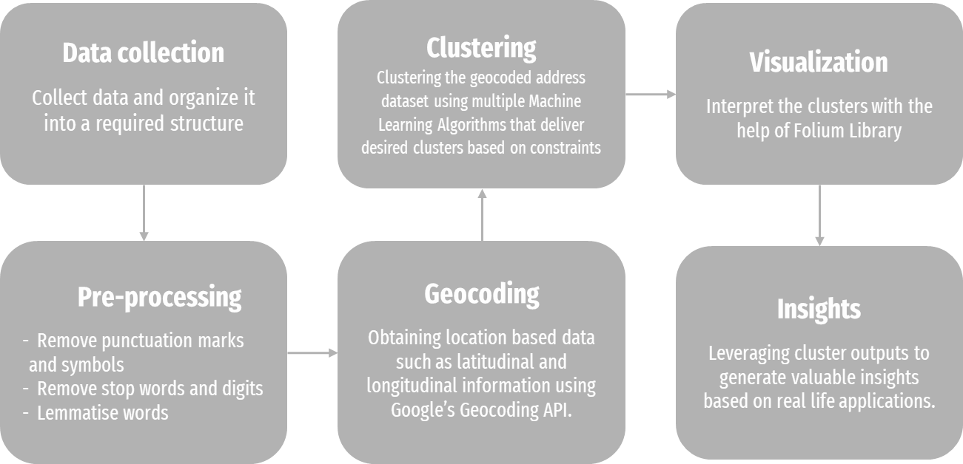
System Architecture & Algorithms

Slide 4
System Architecture & Algorithms
K-Means++ with TSP - K-Means++ ensures smarter initialization of centroids and improves the quality of the clustering. To find the optimal number of K that fits our problem, we are defining clusters such that total routing distance to traverse all the points within a cluster is less then the defined threshold (distance in meters).
SOM (Self Organizing Maps) - SOM allow us to efficiently define clusters as it functions differently as other artificial neural networks, it doesn’t learn by backpropagation with SGD, it use competitive learning to adjust weights in neurons.
It consists of 3 steps: Competition, Cooperation, Adaption

Slide 5
System Architecture & Algorithms
Equal Size Spectral Clustering - Spectral clustering is a popular machine learning technique used for clustering data, including geospatial data using latitudinal and longitudinal information.
Spectral clustering is very powerful at aggregating spatial data because it identifies communities of nodes in a graph based on the edges connecting them.

Slide 6
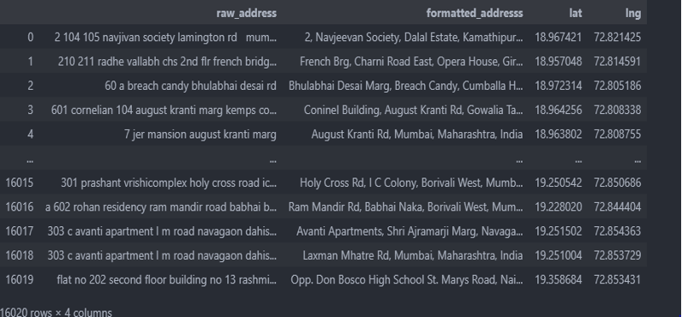
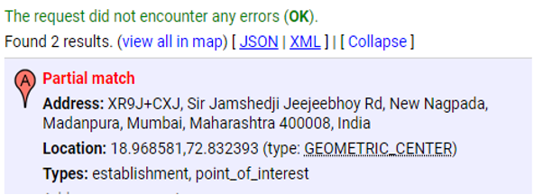
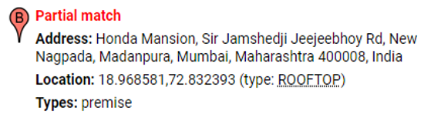
Datasets
Data is collected from a Github repository hosted by a Machine Learning Research Group at Universite Laval named GRAAL / GRAIL [3].
Data extracted from multiple sources is cleaned and combined into one dataframe to proceed with geocoding, and while geocoding, we found some addresses to have multiple partial matches for the raw addresses, so it was ideal to extract all the matches into “formatted addresses”.
Further, we found out the pincodes with maximum number of addresses and filtered out the dataset for testing clustering within that region.

Slide 7
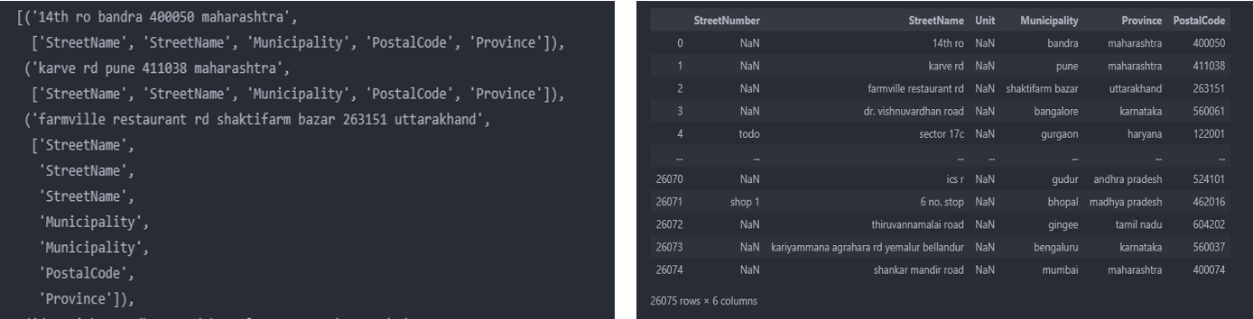
Preprocessing
Fig 1: The data in the raw form is unstructured and unorganized
Fig 2: Dataset after transforming the data into tabular form
To begin with, the raw data is in unstructured manner. In order to transform the data into structured form, the team designed a script to convert the data into tabular form. Through this procedure, the team accomplished a data set to employ further data processing methods including data cleaning, modeling and sampling.

Slide 8
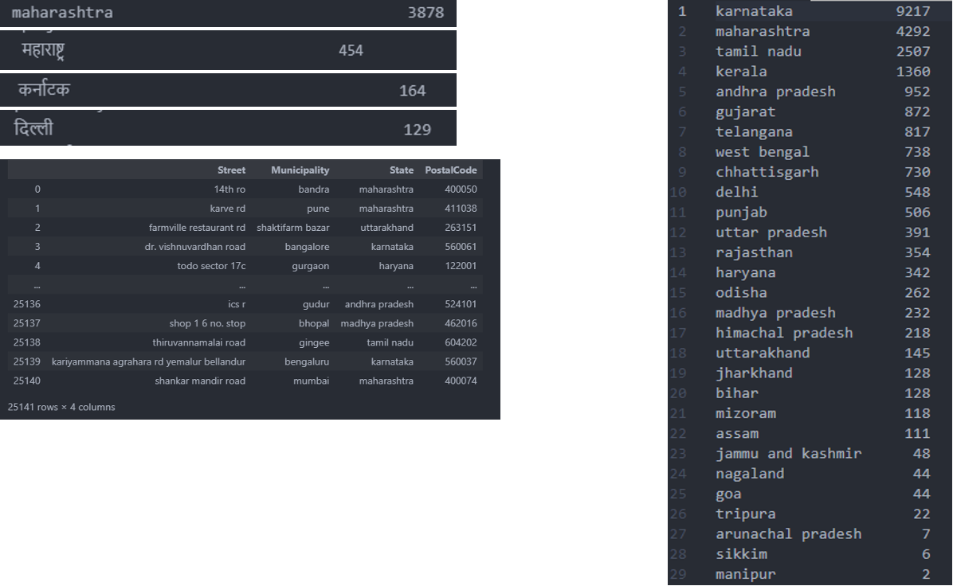
Preprocessing
As the second phase, the team added derived data such as addresses concatenating Street Number, Street Name, and Unit into Street
Furthermore, In data cleaning step, the team observed multilingual entries in the raw data and as a measure to tackle these discrepancies, the team leveraged the GoogleTrans API to classify these addresses into the 29 states of India.
The figure depicts the earlier and cleaned version of the dataset.

Slide 9
Evaluations
Approach / Evaluation metrics | Silhouette score | CH index
K-means with Route Optimization using TSP (k = 25 for threshold 3500m) | 0.44143 | 1662.51073
K-means with elbow method (k = 15) | 0.43526 | 1516.68896
Equal Size Spectral Clustering (k = 12) | 0.34883 | 846.64226
SOM (Self Organizing Maps) | 0.37979 | 859.89787

Slide 10
Evaluations
K-means + TSP Optimization: Best performance with the highest silhouette score of 0.44143 and CH index of 1662.51073, indicating tight clusters well separated from each other.
K-means with Elbow Method: Slightly lower performance than TSP-optimized K-means, with a silhouette score of 0.43526 and CH index of 1516.68896.
Equal Size Spectral Clustering: Lower quality clustering with a silhouette score of 0.34883 and CH index of 846.64226.
SOM (Self Organizing Maps): Moderate clustering quality with a silhouette score of 0.37979 and CH index of 859.89787, better than spectral clustering but significantly lower than both K-means approaches.

Slide 11
Preliminary Findings
Enhanced Clustering Performance: Transitioned from general clustering methods to specifically using K-Means with TSP optimization, which demonstrated significantly improved performance metrics (higher silhouette scores and CH index).
Effective Multilingual Data Management: Progressed from initial plans to address multilingual data issues to successfully implementing GoogleTrans API, which improved data classification and usability for clustering.
Practical Use of SOM: Advanced the application of Self-Organizing Maps from a theoretical approach to a practical clustering tool, yielding moderate success in address clustering.
Advanced Data Structuring: Evolved from preparing and cleaning data to transforming raw unstructured data into a well-structured tabular format, crucial for effective machine learning processes.

Slide 12
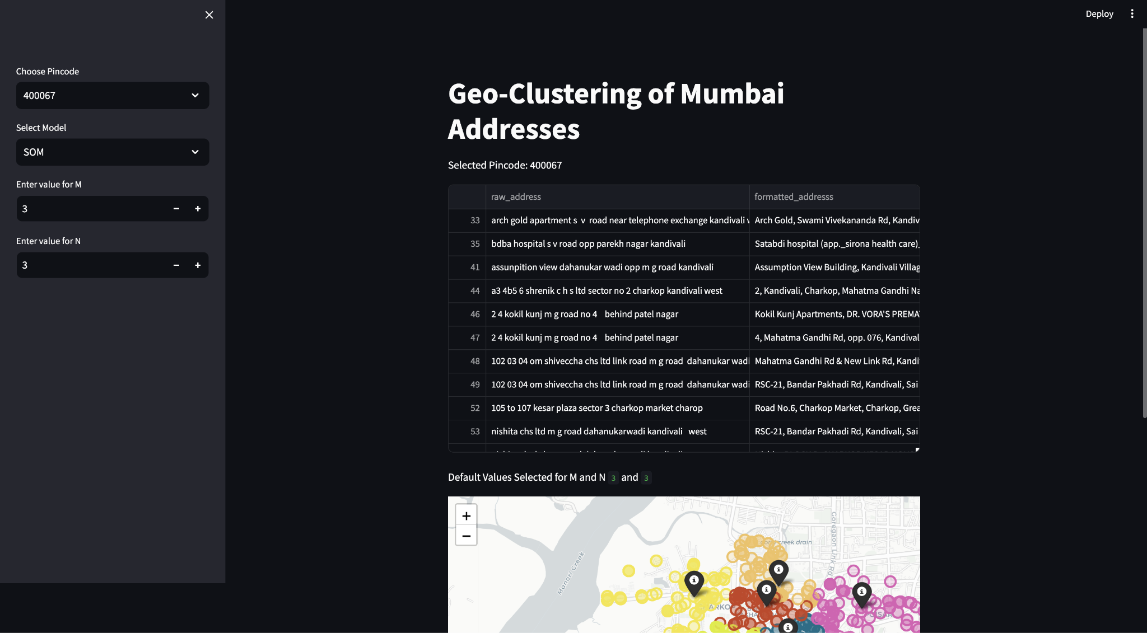
UI Interfaces

Slide 13
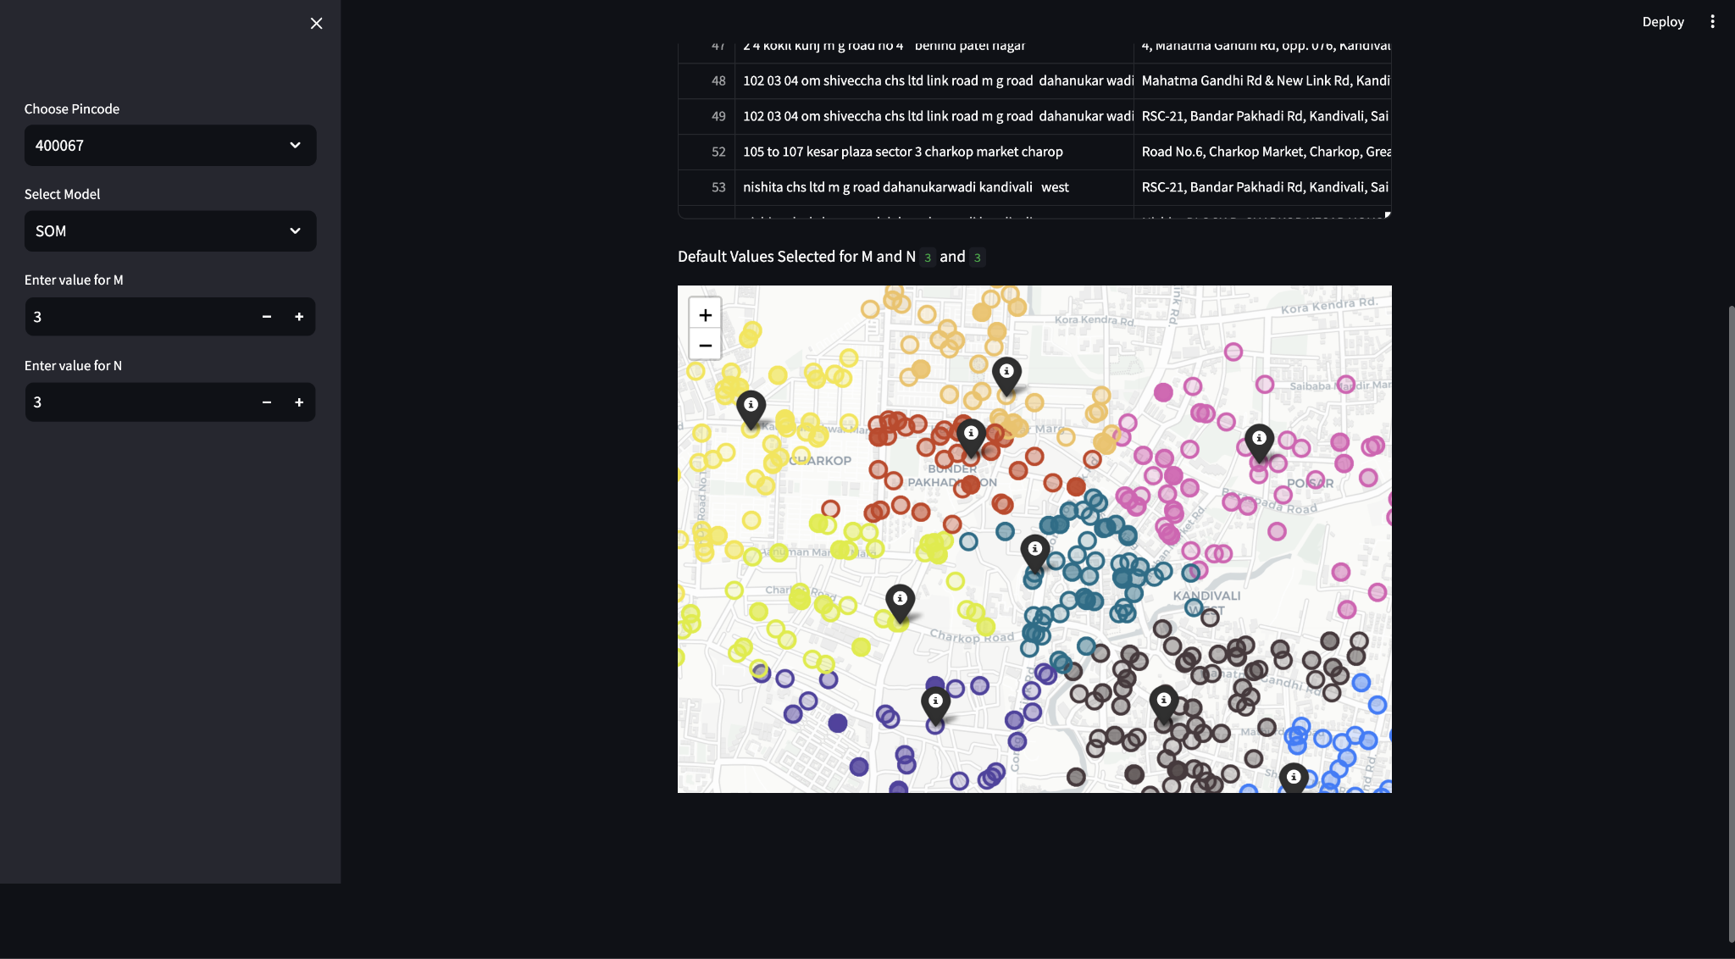
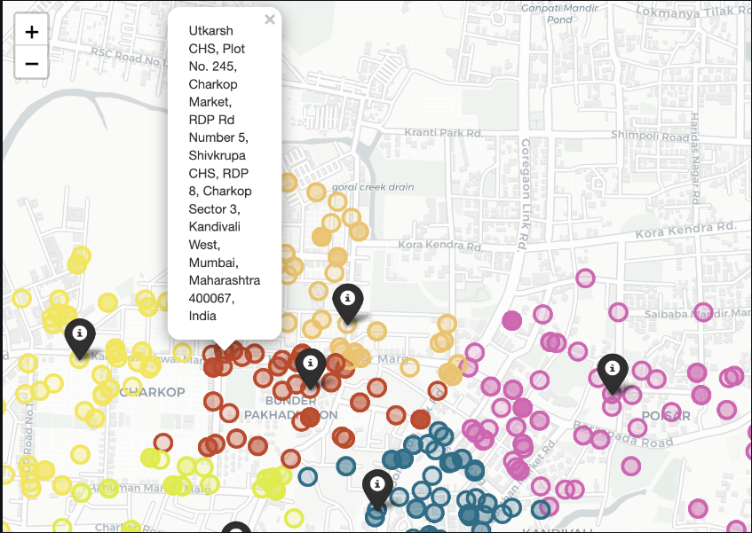
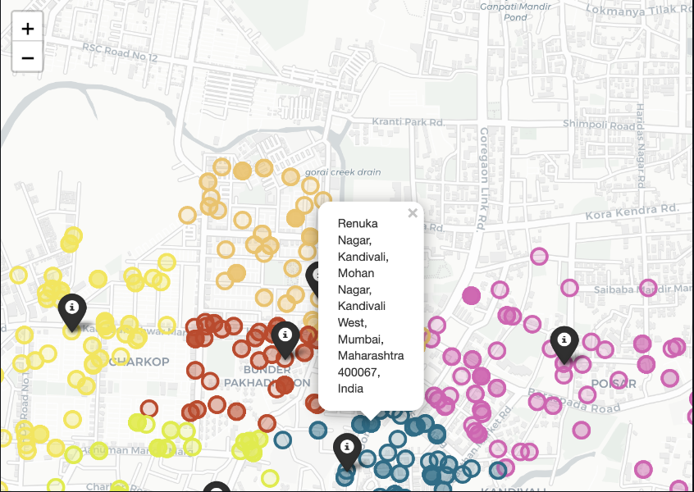
Data Visualization

Slide 14
Project Plan
Task | Description | Deadline | Division of Work
Reference & Problems | Collecting information and reference. Analyze the difficulties that we are facing. | 02/19/2024 | Xinyuan Wang
Challenge Definition | Identify the specific logical challenges. Get corresponding solutions for the challenges. | 02/26/2024 | Aditya Mehta
Dataset Preparation | Gather and download datasets we need. Perform data sorting and organizing. | 03/11/2024 | Manav Kamlesh Parmar
Method Development | Select and evaluate ML and DL models. Optimize models through tests and develop functional UI. | 03/25/2024 | Soumya Gupta
Implementation & Test | Ready for Project Presentation on April 1, 2024. Apply selected ML and DL models to cluster address datasets. | 04/01/2024 | Vanshaj Gupta
Result Analysis | Ready for Group Demo Presentation on April 22, 2024. Optimize the models based on analysis to improve performance. | 04/22/2024 | Everyone Presentation
Conclusion | Ready to turn in Final Project Report on May 1, 2024. Propose directions for future research including possible applications. | 04/29/2024 | Andi Lian

Slide 15
GitHub Repository Link
https://github.com/Vanshaj5101/Address-Clustering-Optimization/tree/main

